Slide 1
Social Networks in Internet based ICT
Assignment 2: Research Proposal
COVID-19 infection data analysis
: Research proposal
Group 4:
Sangho Nam, Seungyong Lee, Jieon Park, Seungmin Kim

Slide 2
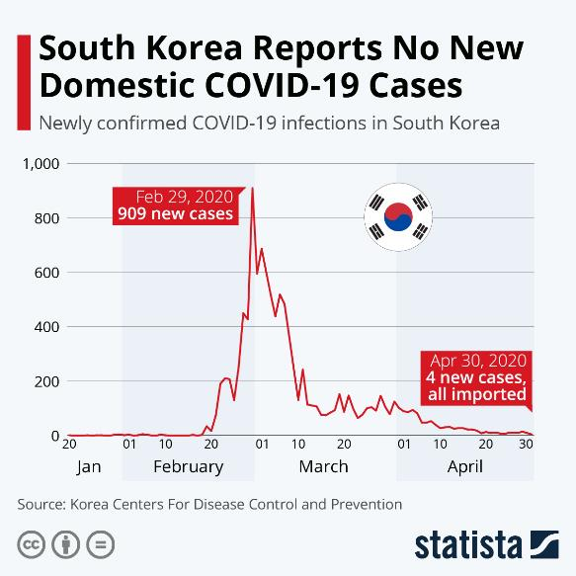
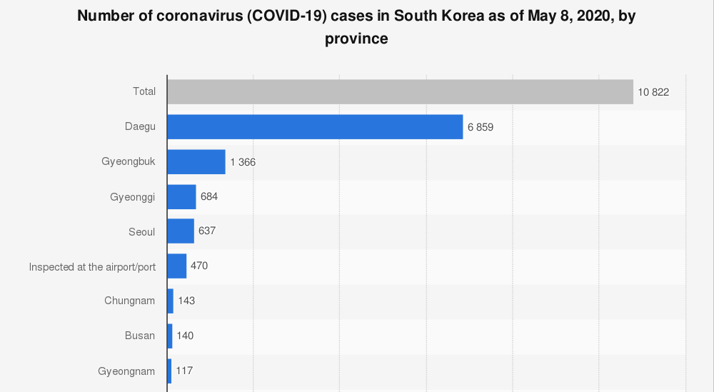
1. Problem description
After the 31st case, the infection rate drastically soared up
<Figure 1. South Korea Reports No New Domestic COVID-19 Cases>
<Figure 2. Number of coronavirus cases in South Korea as of May 8, 2020, by province>
Regarding the local population (Daegu = 2.5 milion / Seoul = 10 million), it is likely to be concluded that 31st outbreak coupled with regional characteristic, or incident, to explode the number of infection cases
While obviously evidential cause, the shincheonji cult, was revealed the situation seemed to be extinguished eventually
Source : Statista
Notes:
https://www.statista.com/chart/21095/covid-19-infections-in-south-korea/
https://www.statista.com/statistics/1100120/south-korea-coronavirus-cases-by-province/

Slide 3
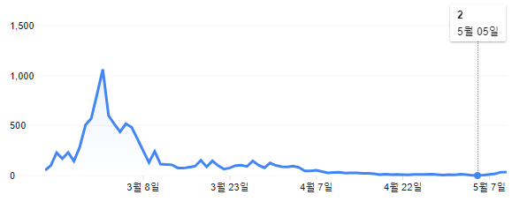

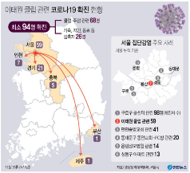
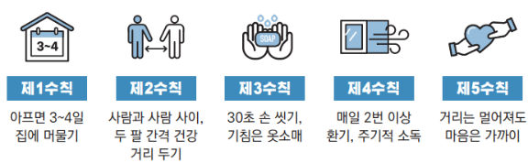
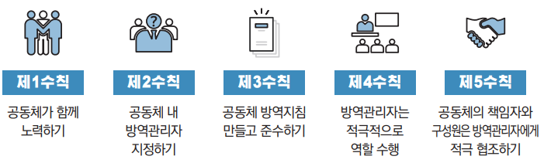
1. Problem description
Decreasing of confirmed case of COVID-19 in South Korea
Detailed ‘keeping distance from life’ Guidance required
‘keeping distance from life’ Guidance contain 5 Personal prevention rules and 5 group prevention rules
Efficient detailed ‘keeping distance from life’ Guidance required
Apply differently in place, region, age etc.
On May 5, South Korea Ends Its ‘Social Distancing’ Guidelines
On May 6, Transition to ‘Keeping distance from life’
On May 11, Infections in Itaewon cluster rise to at least 86 people
<Figure 3. 코로나 19 한국 확진자 (Corona 19 Korean Confirmed Patients) >
<Figure 4. Itaewon COVID 19 >
<Figure 5. Itaewon COVID 19 current status>
<Figure 6.Guidance for keeping distance (Personal prevention)>
<Figure 7. Guidance for keeping distance (Group prevention)>
Source : Wikipedia.org, Jejudomin ilbo, Yonhap News, Ministry of Health and Welfare
Notes:
“코로나 19 한국 확진자”, 「Wikipedia.org」, https://www.google.com/search?q=%EC%BD%94%EB%A1%9C%EB%82%98+19+%ED%95%9C%EA%B5%AD+%ED%99%95%EC%A7%84%EC%9E%90&oq=%EC%BD%94%EB%A1%9C%EB%82%98+1&aqs=chrome.0.69i59l2j69i57j69i60j69i61l2.4471j0j7&sourceid=chrome&ie=UTF-8

Slide 4
2. Research question
What is the property of COVID-19 infected patients’ network?
What is the form of COVID-19’s network? Is it a scale-free network?
What is the relation between infected patients? Does is show a small world effect?
(Implication) An empirical analysis of the severity of the situation due to the close association of COVID-19 network types and infected patients
If super spreaders exist, how can we define them?
Does a super spreaders exist?
What kind of measures will be eligible to define super spreaders?
(Implication) Prevention method of the epidemic based on detection of super spreaders and analysis of the characteristics of the patient concerned
Is there any difference in the form of network depending on each area or location of infection?
a. Analysis on network shape differences according to each infected area or location
(Implication) Differentiation on the method of epidemics prevention reflecting the different characteristics found on respective infected area
Notes:
(although difficult) please find here also some research questions that can be answered with a specific network measure

Slide 5
3. Data: Table field description
PatientRoute
The line between columns means that values of columns are partially shared.
Column | Description | Type
Patient_id | the ID of the patient | int
Global_num | the number given by KCDC | int
date | YYYY-MM-DD | date
province | Special City / Metropolitan City / Province(-do) | str
city | City(-si) / Country (-gun) / District (-gu) | str
type | the type of the visit | str
latitude | the latitude of the visit (WGS84) | float
longitude | the longitude of the visit (WGS84) | float
Region
PatientInfo
Column | Description | Type
code | the code of the region | int
province | Special City / Metropolitan City / Province(-do) | str
city | City(-si) / Country (-gun) / District (-gu) | str
latitude | the latitude of the visit (WGS84) | float
longitude | the longitude of the visit (WGS84) | float
elementary_school_count | the number of elementary schools | int
kindergarten_count | the number of kindergartens | int
university_count | the number of universities | int
academy_ratio | the ratio of academies | float
elderly_population_ratio | the ratio of the elderly population | float
elderly_alone_ratio | the ratio of elderly households living alone | float
nursing_home_count | the number of nursing homes | int
Column | Description | Type
Patient_id | the ID of the patient | int
Infected_by | the ID of who infected the patient | int
Global_num | the number given by KCDC | int
sex | the sex of the patient | str
Birth_year | the birth year of the patient | int
age | the age of the patient | str
country | the country of the patient | str
province | the province of the patient | str
city | the city of the patient | str
disease | TRUE: underlying disease / FALSE: no disease | bool
Infection_order | the order of infection | int
Infection_case | the case of infection | str
Contact_number | the number of contacts with people | int
Symptom_onset_date | the date of symptom onset | date
Confirmed_date | the date of being confirmed | date
Released_date | the date of being released | date
Deceased_date | the date of being deceased | date
state | isolated / released / deceased | str
Case
Column | Description | Type
Case_id | the ID of the infection case | int
province | Special City / Metropolitan City / Province(-do) | str
city | City(-si) / Country (-gun) / District (-gu) | str
group | TRUE: group infection / FALSE: not group | bool
Infection_case | the infection case (the name of group or other cases) | str
confirmed | the accumulated number of the confirmed | int
latitude | the latitude of the group (WGS84) | float
longitude | the longitude of the group (WGS84) | float
<Figure 8. Data description>
Source : Kaggle - Data Science for COVID-19 (DS4C)
Data update: Up-to-date dataset until 2020-05-14

Slide 6
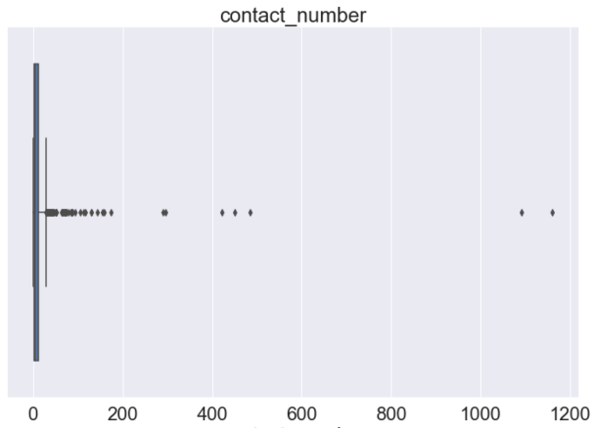
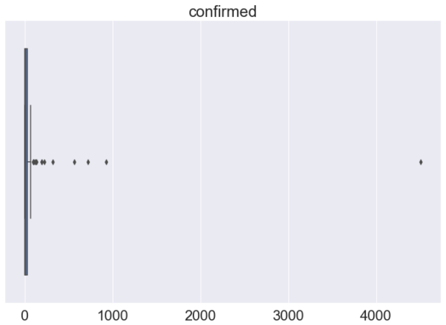
3. Data: Sanity check
Null values
Outlier
fgh
Table | Column | Null value ratio (%)
Patient_info | Global_num | 32%
 | Sex | 2%
 | Birth_year | 13%
 | Age | 2%
 | City | 2%
 | Disease | 99%
 | Infection_case | 22%
 | Infection_order | 99%
 | Infected_by | 75%
 | Contact_number | 81%
 | Symptom_onset_date | 85%
 | Confirmed_date | 0.1%
 | Released_date | 60%
 | Deceased_date | 98%
Patient_route | global_num | 46%
Onchun Church case
Shincheonji Church case
Shincheonji Church case
<Figure 9. Sanity check for null values>
Source : Kaggle - Data Science for COVID-19 (DS4C)

Slide 7
4. Procedure of analysis
COVID-19 infection network’s characteristic analysis (Research question 1)
Is it a scale-free network (power laws form)? Is the logarithm of the degree distribution liner? <degree distribution>
Does the network show small world effect? <mean distance of network>
2. Analysis on super spreaders (Research question 2)
If it shows form of the power laws, does it have a right-shewed hub (or super spreader) ? <degree distribution>
What type of degree centrality will be appropriate for defining super spreader? (degree centrality, eigenvector centrality, katz centrality, page rank, betweenness centrality, and etc…) <degree centrality>
3. Region or Location network analysis (Research question 3)
What is the degree distribution of each region’s or location’s network? <degree distribution>
Is there any difference between each region’s or location’s network? <degree distribution>, <number of components>, < KL-divergence>
Notes:
please make sure that the research questions can be addressed with the procedure of analysis proposed

Slide 8
5. The measures
1. COVID-19 infection network characteristic analysis
mean distance of network: identify existence of small world effect
degree distribution: check scale-free network or not
2. Analysis on super spreaders
degree distribution: identify existence of hub
degree centrality: What type of degree centrality will be appropriate to define super spreaders? (degree centrality, eigenvector centrality, katz centrality, page rank, betweenness centrality 등
3. Region or Location network analysis
degree distribution, number of components, KL-divergence: Is there any difference between each region’s or location’s network?
Notes:
please make sure that the measures are linked to some research questions

Slide 9
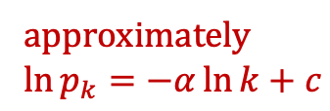
6. Analysis: network characteristic analysis
The type of COVID-19 network : By analyzing degree distribution, we concluded that the COVID-19 infection network is a scale-free network. Therefore, we detected hubs (key infected patients) that has high centrality among the overall nodes.
Relationships between patients: By analyzing closeness centrality distribution and mean distance (1.31), we concluded that small-world effect does exist and therefore the patients are highly relevant.
If the color of node is red, then its degree centrality is over 10. (Hub)
Degree distribution of network
approximately
$$\ln{p_{k}}=−α\ln{k}+c$$
Closeness centrality distribution of network (mean = 1.31)
Degree distribution of network (logarithmic scale)
Notes:
COVID-19 네트워크 형태 : Degree distribution 을 통해서 확인했을 때, COVID-19 감염 네트워크는 scale-free networ 임. 따라서, 전체 node 중에서 centrality 가 높은 hub (주요 감염환자)를 확인할 수 있음.
환자 간의 관련성: closeness centrality distribution 및 mean distance (1.31)을 통해서 볼 때, small-world effect가 존재하고 따라서 환자 간 관련성이 매우 큼.

Slide 10
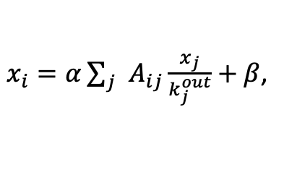


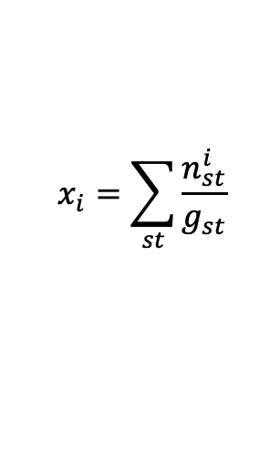
6. Analysis: super spreaders
Existence of hub confirmed: As the degree distribution is right-skewed, the hub that has high centrality among the entire node exists.
Comparison result of centrality measure: Concluded that betweenness centrality is appropriate in considering contribution to the infection process.
1) Degree centrality distribution
$$x_{i}=\sum_{j=1}^{n}{A_{ij}}$$
2) Katz centrality distribution
$x_{i}=α\sum_{j}{A_{ij}x_{j}}+β$,
Pros: Simple calculation and meanings
Cons: Need to consider the contributions to the infection process, potential propagation risks, etc.
Pros: Considering the potential risk of individual patients is possible
Cons: Contribution to the infection process is not considered
Hub
Hub
3) Page rank distribution
4) Betweenness centrality distribution
$$x_{i}=\sum_{st}{\frac{n_{st}^{i}}{g_{st}}}$$
$x_{i}=α\sum_{j}{A_{ij}\frac{x_{j}}{k_{j}^{out}}}+β$,
Pros: Centrality normalization on each vertex
Cons: Contribution to the infection process is not considered
Pros: Appropriate in measuring contribution to the infection process, appropriate in measuring the spread between different groups (broker)
Hub
Hub
Notes:
Hub 존재: degree distribution이 right-skewed하므로, 전체 node 중에서 centrality 가 높은 hub (주요 감염환자) 존재
Centrality measure 비교 결과: Betweenness centrality 가 감염 과정에서의 기여를 고려하기에 적합하다고 판단
Degree centrality: 계산 및 의미가 단순해서 좋음. 그러나 감염 과정에서의 기여 및 개별 환자의 잠재적 전파 위험 고려 안됨
Katz centrality: beta로 개별 환자의 잠재적 전파 위험 고려. 그러나 감염 과정에서의 기여도 고려 안됨.
Pagerank distribution: vertex마다 outgoing line의 centrality normalize. 그러나 감염 과정에서의 기여도 고려 안됨.
Betweenness centrality: 감염 경로에서 얼마나 기여했는지 측정하기 적절함, 서로 다른 그룹 간 전파 측정 가능 (broker)

Slide 11
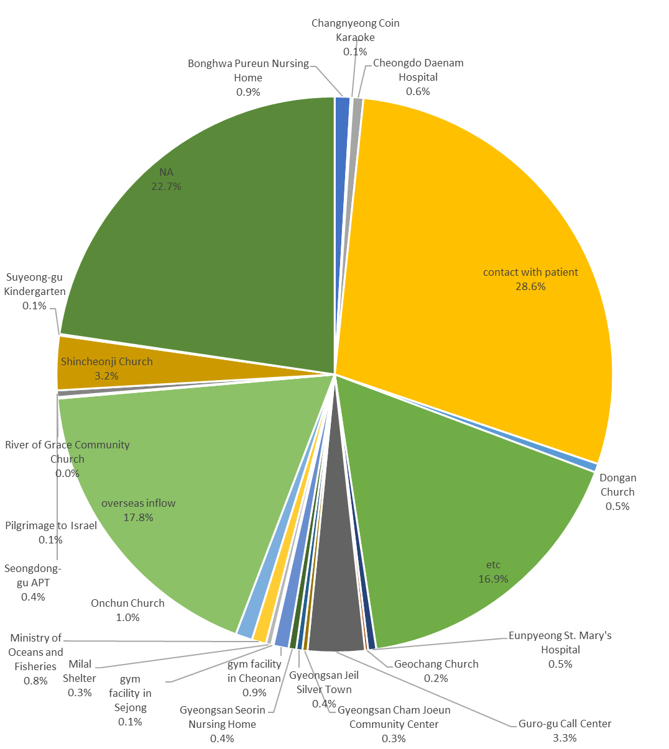
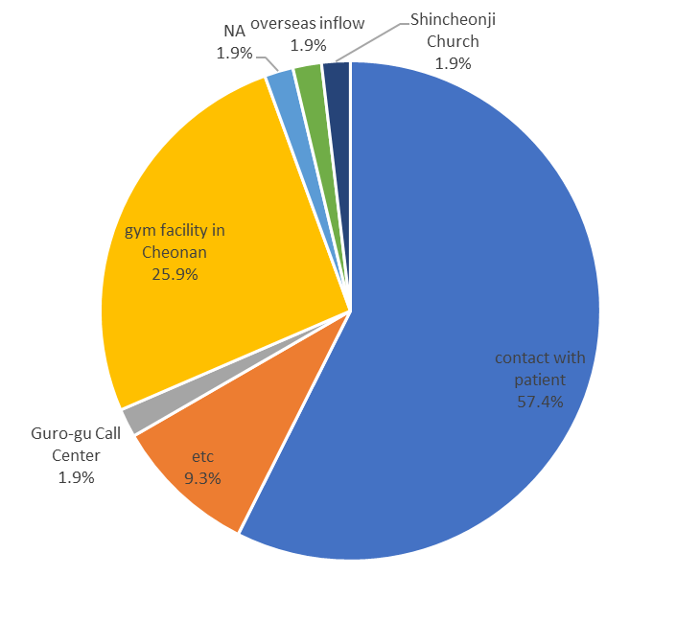
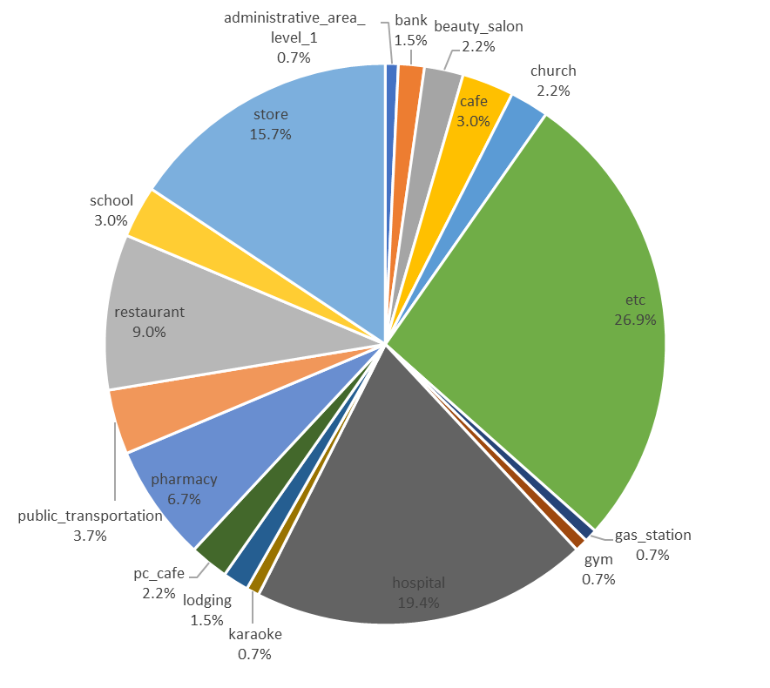
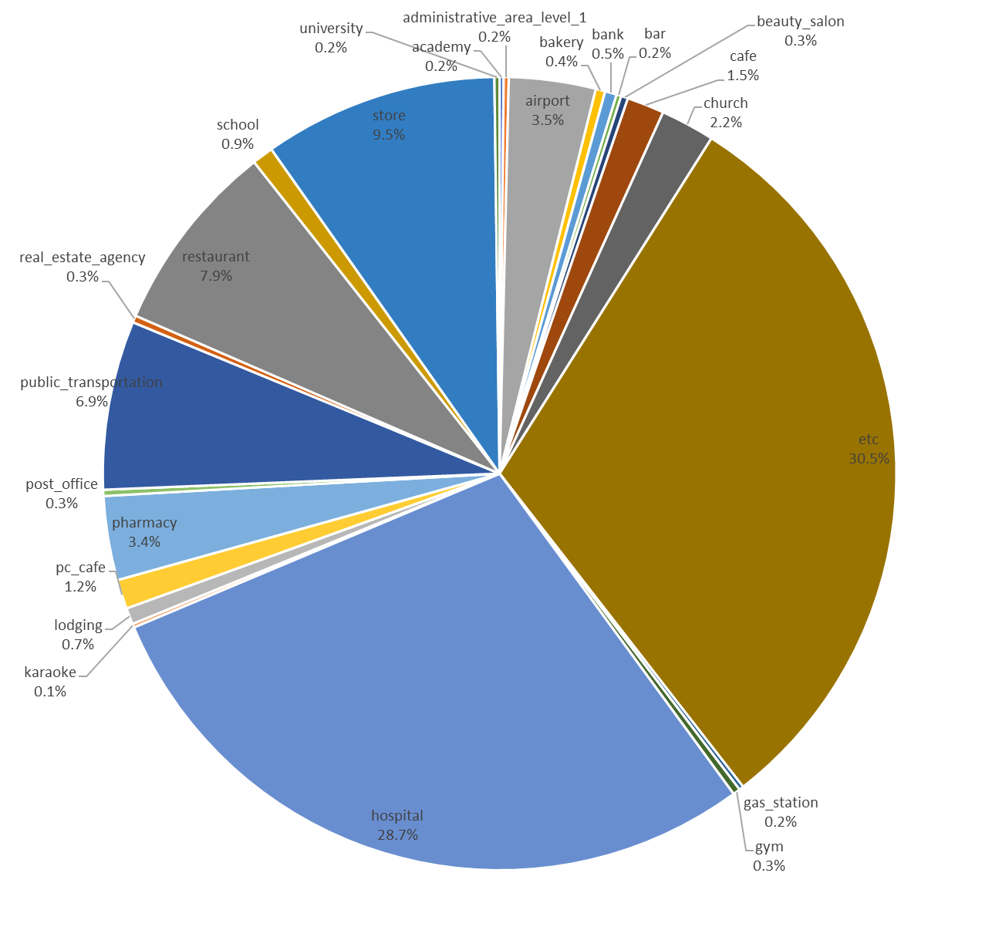
6. Analysis: super spreaders
Detailed ‘Keeping distance from life’ Guidance
1. Need more quarantine focus on store, school and gym facility
super-spreader infected by ‘contact with patient’ rather than group infection
super-spreader had visited stores, school and gym facility more than all patients
<Super-spreader’s infection case>
<All patient’s infection case>
<Super-spreader’s route type>
<All patient’s route type>
54 Patients, top 5% betweenness centrality in 1073 patients, are designated as Super-spreader
Notes:
슈퍼전파자의 감염경로는 그룹 감염(신천지, 구로콜센터 등)이나 해외 감염 보다 개인 접촉 감염이 많음.
즉, 교회, 오피스, 공항 등에 통제는 잘되고 있으나 개인 감염의 통제가 되지 않으면 슈퍼전파자에 의한 감염이 많아짐.
2. 슈퍼전파자의 감염경로에 gym facility in cheonan 그룹감염이 높게 나오는데 이는 슈퍼전파자의 활동성(?)에 따른 것으로 추정....
따라서 체육시설에 대한 집중 통제 필요
3. 슈퍼전파자의 이동경로와 전체 감염자의 이동경로를 비교해보면 슈퍼전파자의 이동경로 중 일반가게, 학교 등의 비중이 높게 나옴
따라서 일반 가게와 학교에 대한 감염 통제 필요

Slide 12
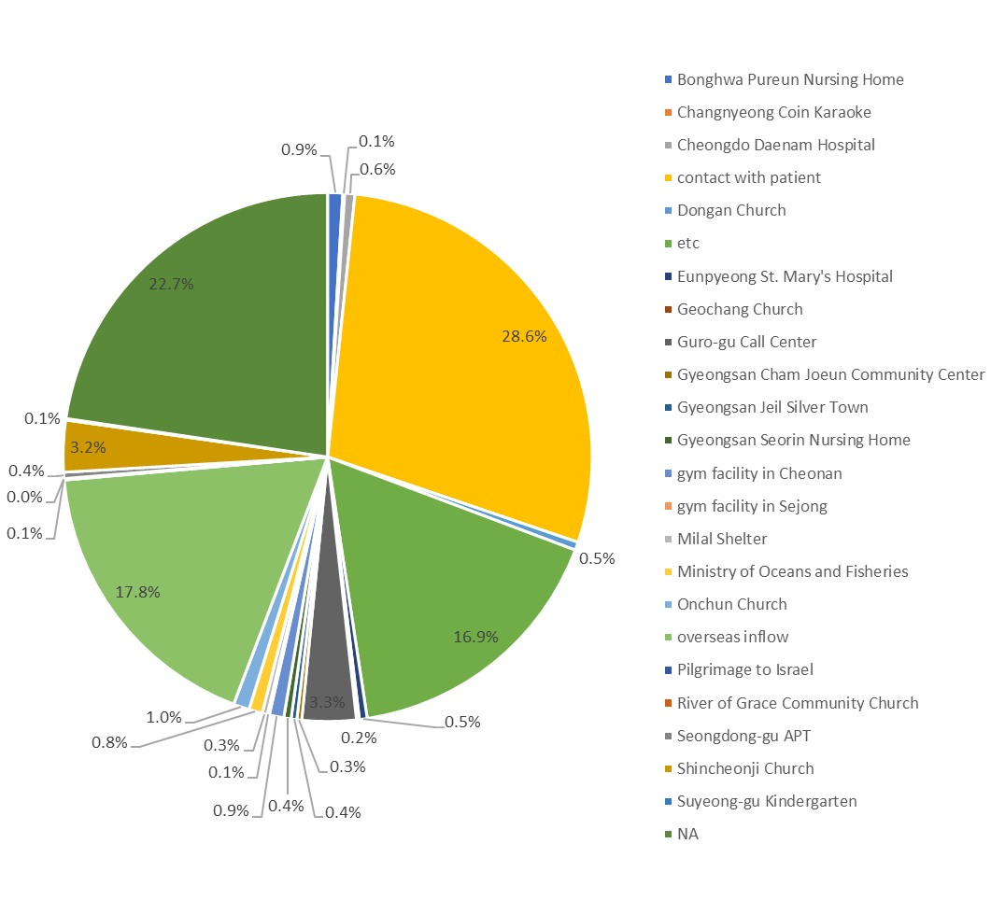
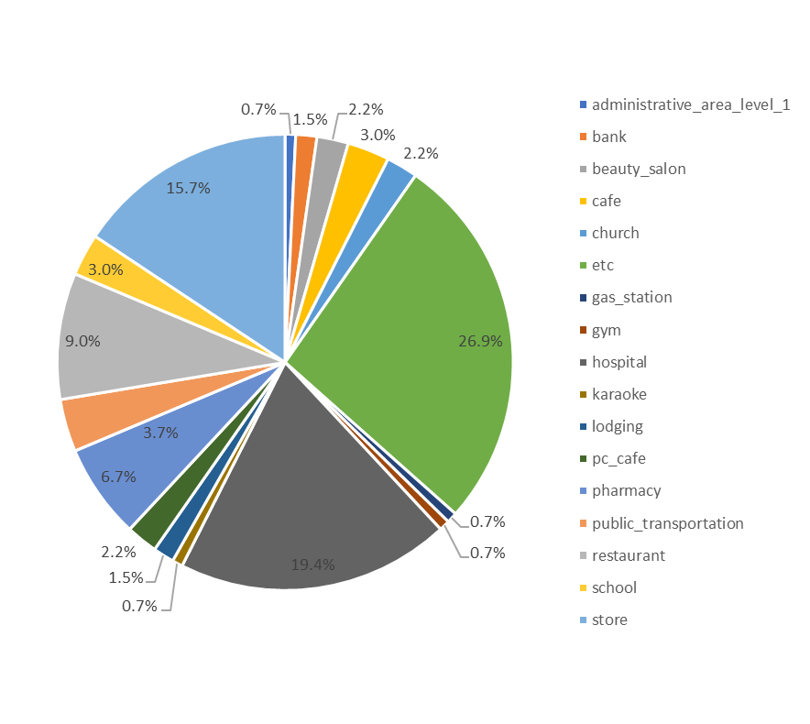
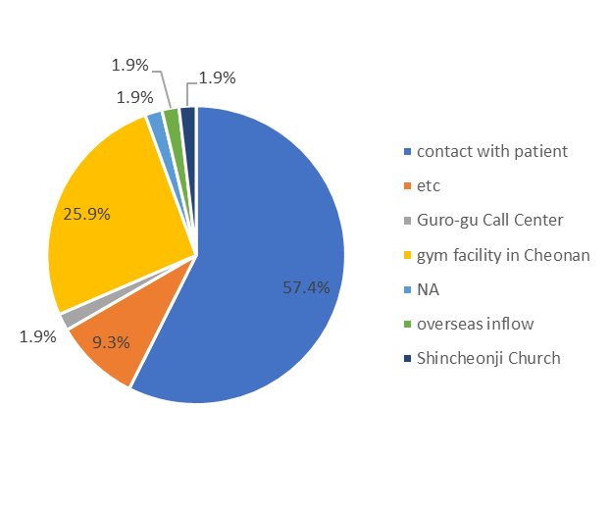
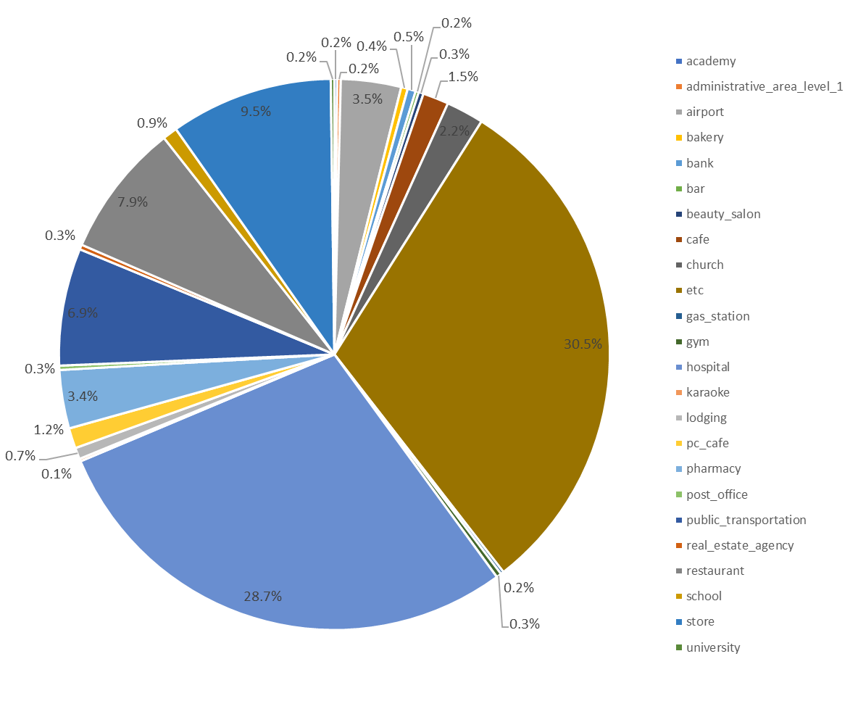
6. Analysis: super spreaders
Detailed ‘Keeping distance from life’ Guidance
1. Need more quarantine focus on store, school and gym facility
super-spreader infected by ‘contact with patient’ rather than group infection
super-spreader had visited stores, school and gym facility more than all patients
<Super-spreader’s infection case>
<All patient’s infection case>
<Super-spreader’s route type>
<All patient’s route type>
54 Patients, top 5% betweenness centrality in 1073 patients, are designated as Super-spreader
Notes:
슈퍼전파자의 감염경로는 그룹 감염(신천지, 구로콜센터 등)이나 해외 감염 보다 개인 접촉 감염이 많음.
즉, 교회, 오피스, 공항 등에 통제는 잘되고 있으나 개인 감염의 통제가 되지 않으면 슈퍼전파자에 의한 감염이 많아짐.
2. 슈퍼전파자의 감염경로에 gym facility in cheonan 그룹감염이 높게 나오는데 이는 슈퍼전파자의 활동성(?)에 따른 것으로 추정....
따라서 체육시설에 대한 집중 통제 필요
3. 슈퍼전파자의 이동경로와 전체 감염자의 이동경로를 비교해보면 슈퍼전파자의 이동경로 중 일반가게, 학교 등의 비중이 높게 나옴
따라서 일반 가게와 학교에 대한 감염 통제 필요

Slide 13
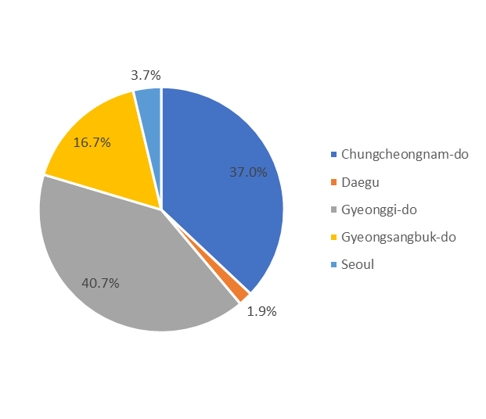
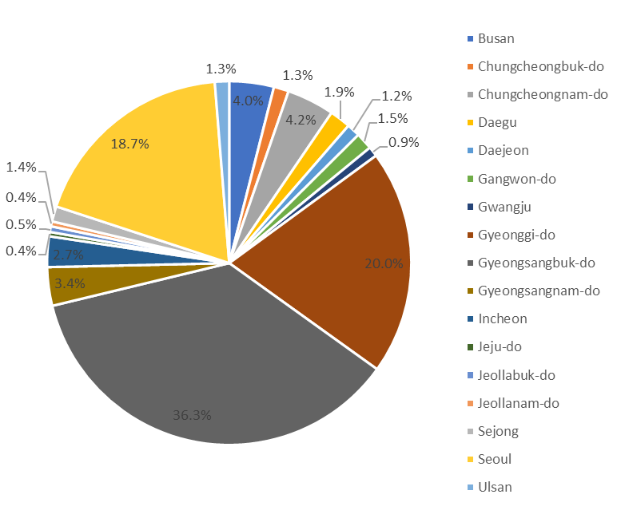
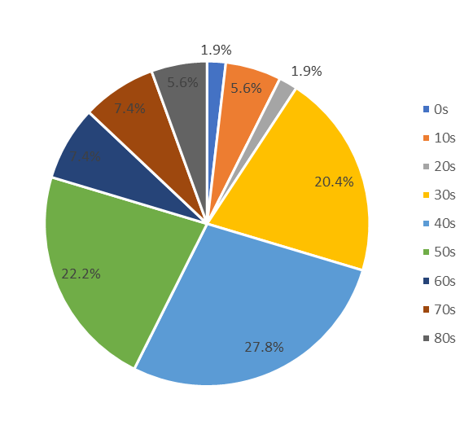
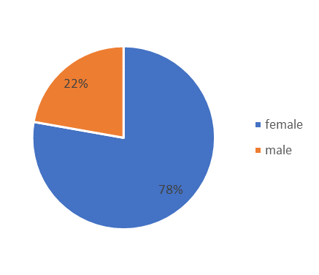
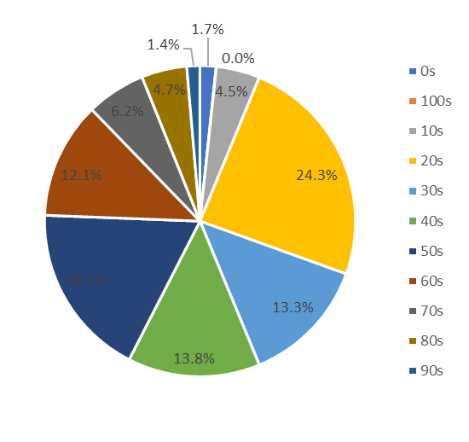
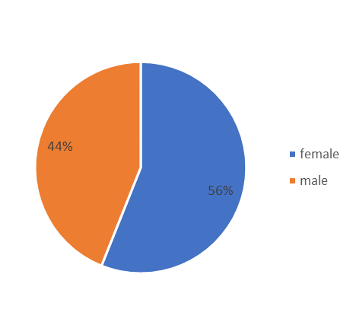
6. Analysis: super spreaders
Detailed ‘Keeping distance from life’ Guidance
2. Need more quarantine focus on central region
Super-spreader’s proportion of residents in the central region is high
3. Need more personal quarantine for Individuals with active social activities
There are more super-spreaders in their 30s, 40s, 50s and female.
<Super spreader’s residence>
<All patient’s residence>
<Super-spreader’s age and sex>
<All patient’s age and sex>
54 Patients, top 5% betweenness centrality in 1073 patients, are designated as Super-spreader
Notes:
슈퍼전파자의 거주지가 중부지방(경기도, 충청남도)의 비중이 전체 감염자에 비해 높게 나옴
슈퍼전파자의 나이는 30,40,50대 여성 비중이 전체 감염자에 비해 높게 나옴

Slide 14
6. Analysis: Region or Location network analysis
As each patient's area of infection depends on the movement path, it is difficult to isolate the network based on the area of residence.
Separation by infected area is required according to movement path
Seoul
Network by different colors for different province
Daegu & Gyeongsangbuk-do
Daegu and North Gyeongsang Province are the regions with the most infections, but is a very small network when residents in the area are included.
Notes:
각 환자 마다 감염 지역이 이동 경로에 따라 달라지므로, 거주 지역을 기반으로 네트워크를 분리하기 어려움
이동 경로에 따른 감염 지역 별 분리 필요
대구 경북 지역은 가장 많은 감염이 발생한 지역이나, 해당 지역 거주자만 포함하면 매우 작은 네트워크

Slide 15
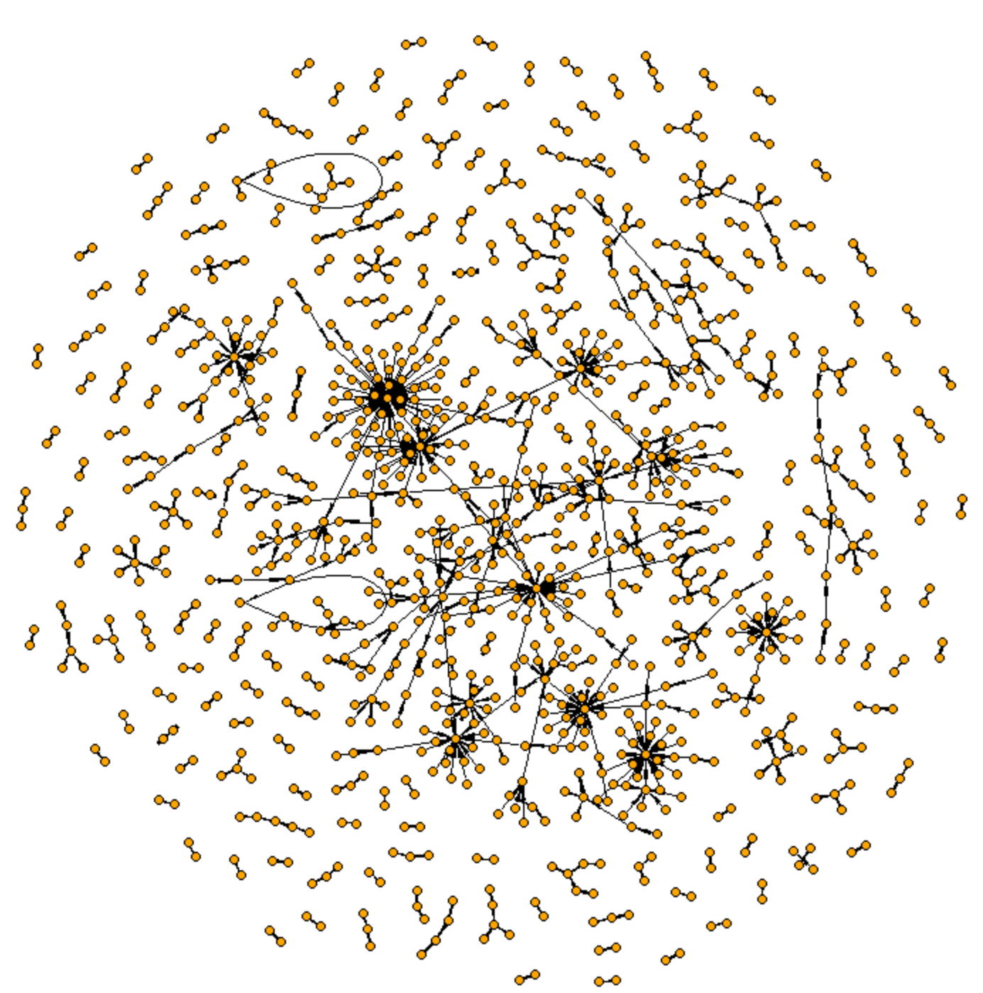
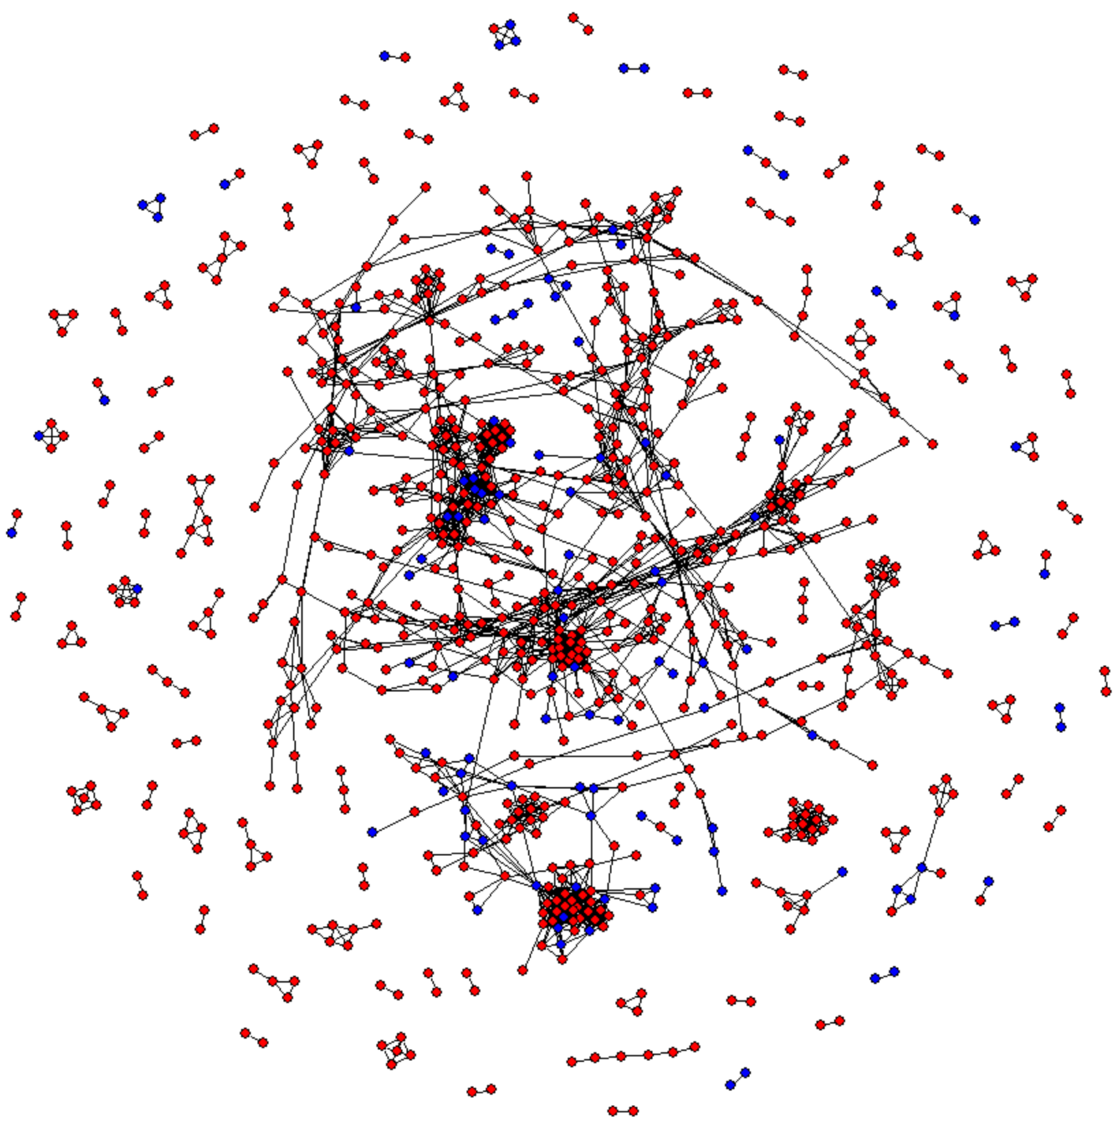
6. Analysis: visit network
Recently, more cases of failure to determine the path of infection
Of the 385 confirmed cases recently, 51 have unknown infection routes(yeonhap new, 2020-06-05)
Visit network can be one of methods to identify infection path.
Blue : Infection path identified
Red : Infection path unidentified
<Identified infection network>
<Visit network>
Based on records of visits to the same place on the same day
Notes:
최근 감염자 감염 경로를 확인하지 못하는 경우가 증가
코로나19 감염경로 확인불가 확진 증가
http://www.mediwelfare.com/news/articleView.html?idxno=2026
동일, 동장소 방문 기록으로 감염경로 추정 방법론 제시?

Slide 16
References
1. Niall McCarthy, “South Korea Reports No New Domestic COVID-19 Cases”, 「Statista」, Apr 30. 2020, https://www.statista.com/chart/21095/covid-19-infections-in-south-korea/
2. “Number of coronavirus (COVID-19) cases in South Korea as of May 8, 2020, by province”, 「Statista」, May 2020, https://www.statista.com/statistics/1100120/south-korea-coronavirus-cases-by-province/
3. “코로나 19 한국 확진자”, 「Wikipedia.org」, https://www.google.com/search?q=%EC%BD%94%EB%A1%9C%EB%82%98+19+%ED%95%9C%EA%B5%AD+%ED%99%95%EC%A7%84%EC%9E%90&oq=%EC%BD%94%EB%A1%9C%EB%82%98+1&aqs=chrome.0.69i59l2j69i57j69i60j69i61l2.4471j0j7&sourceid=chrome&ie=UTF-8
4. 진순현, “'이태원 다녀왔다’ 27명 추가 검사…전원 음성”, 「제주도민일보」, May 12. 2020, http://m.jejudomin.co.kr/news/articleView.html?idxno=124238
5. 김영은, “이태원 클럽 관련 코로나 19 확진자 현황”, 「연합뉴스」, May 11. 2020,
https://www.yna.co.kr/view/GYH20200511002100044
6. 보건복지부, “생활 속 거리 두기 기본 지침 개인방역”, 「코로나바이러스 감염증-19(COVID 19)」, May 6. 2020, http://ncov.mohw.go.kr/guidelineView.do?brdId=6&brdGubun=61&dataGubun=&ncvContSeq=2152&contSeq=2152&board_id=&gubun=
7. “Data Science for COVID-19 (DS4C)”, 「Kaggle」, https://www.kaggle.com/kimjihoo/coronavirusdataset#

